Slide 1




FWP – ROS Dmitrii Dobriborsc Maze Escape using Turtlebot3
Milestone 1: Midway Presentation
Group 4:
Angeles Gil
Contreras Ruben
Gatti Felix
Rojas Felipe

Slide 2

CONTENTS
PROJECT TOPIC
PROJECT GOALS / OBJECTIVES
PROJECT COMPONENTS
PROJECT STATUS

Slide 3
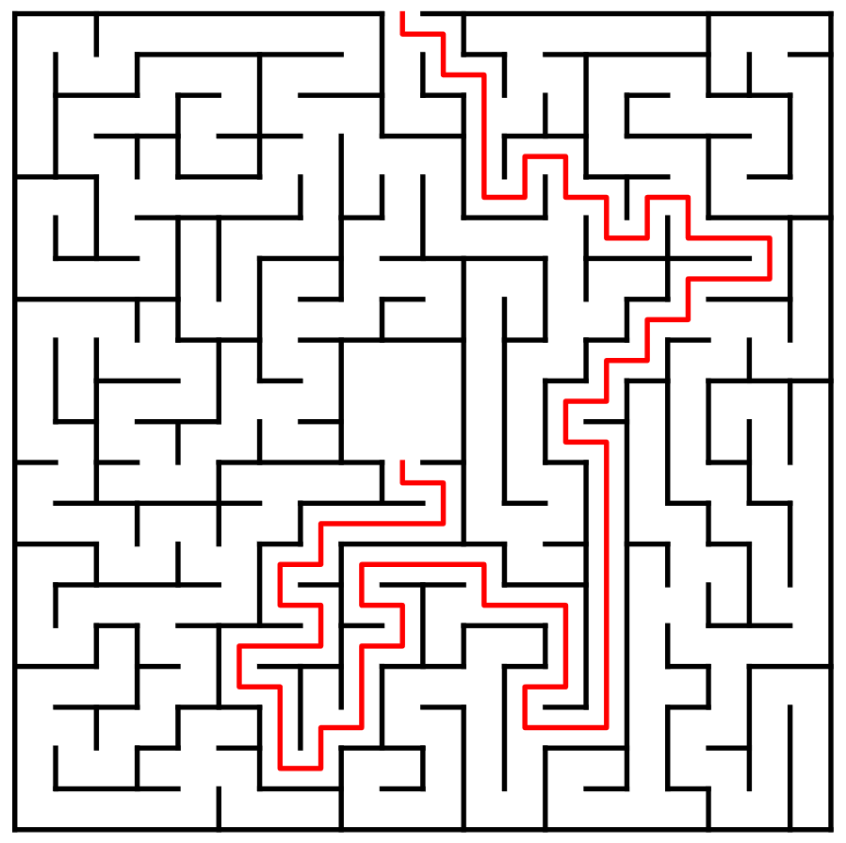
PROJECT TOPIC
DESCRIPTION
The project aim is to develop and implement a search or navigation algorithm that lets the Turtlebot3 solve different kind of maze configurations effectively in a virtual environment.
Scenario A)
“Random Exploration”
Robot has no information of the surrounding maze
Initial escape explores maze according to used algorithm
Second escape uses learned path to escape
Scenario B)
“Goal Finding”
Robot has information about location of exit
Initial escape tries to minimize exploration and minimizes escape time
Second escape uses learned path to escape

Slide 4
GOALS / OBJECTIVES
OBJECTIVES
Create an environment in Gazebo with a Maze that the Turtlebot3 can explore and solve.​
Defining a localization/mapping method to navigate the maze in an ordered behaviour.
Implement a search algorithm for the Turtlebot3 so it can get out of the maze in the fastest way possible.​
Implement the same algorithm in a Real-world scenario, where a Physical Turtlebot3 is able to solve a simple maze.​

Slide 5
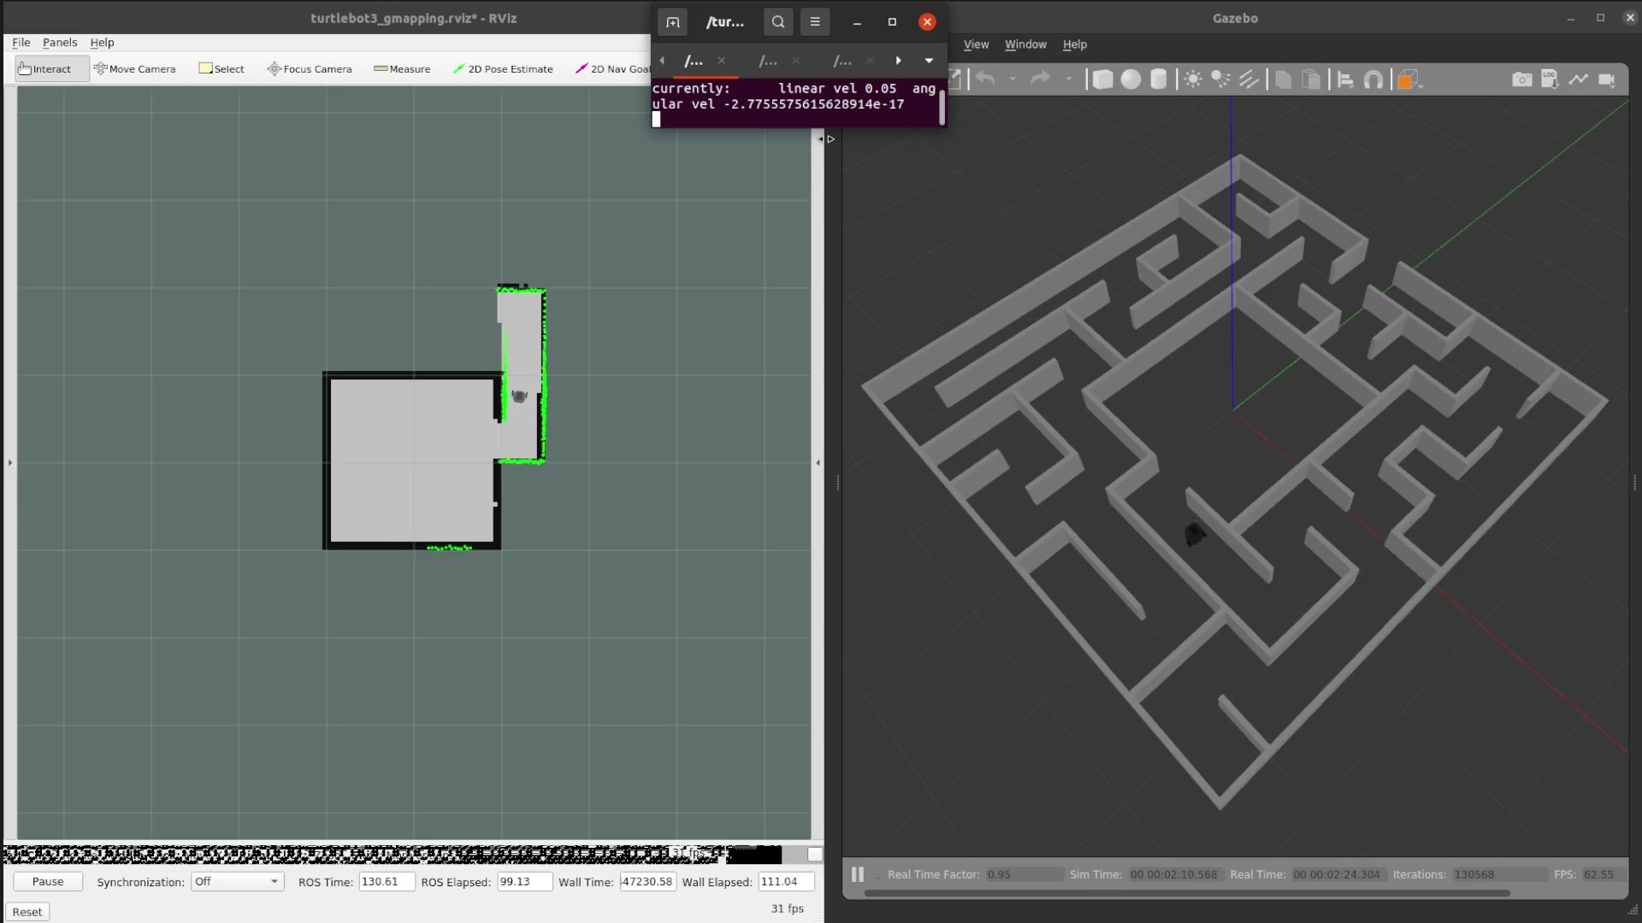
PROJECT COMPONENTS
COMPONENT: MAZE CREATION
Generation of random mazes using online generator
Creation of multiple maze worlds using gazebo
COMPONENT: LOCALIZATION / GENERAL NAVIGATION
Localization / Mapping using SLAM
General Navigation inside maze
Ex. Staying in the middle of maze corridor
COMPONENT: ESCAPE ALGORITHM
Scenario A) (Goal unknown)
Wall following
Dead-end filling
Scenario B) (Goal known)
A* Path search

Slide 6
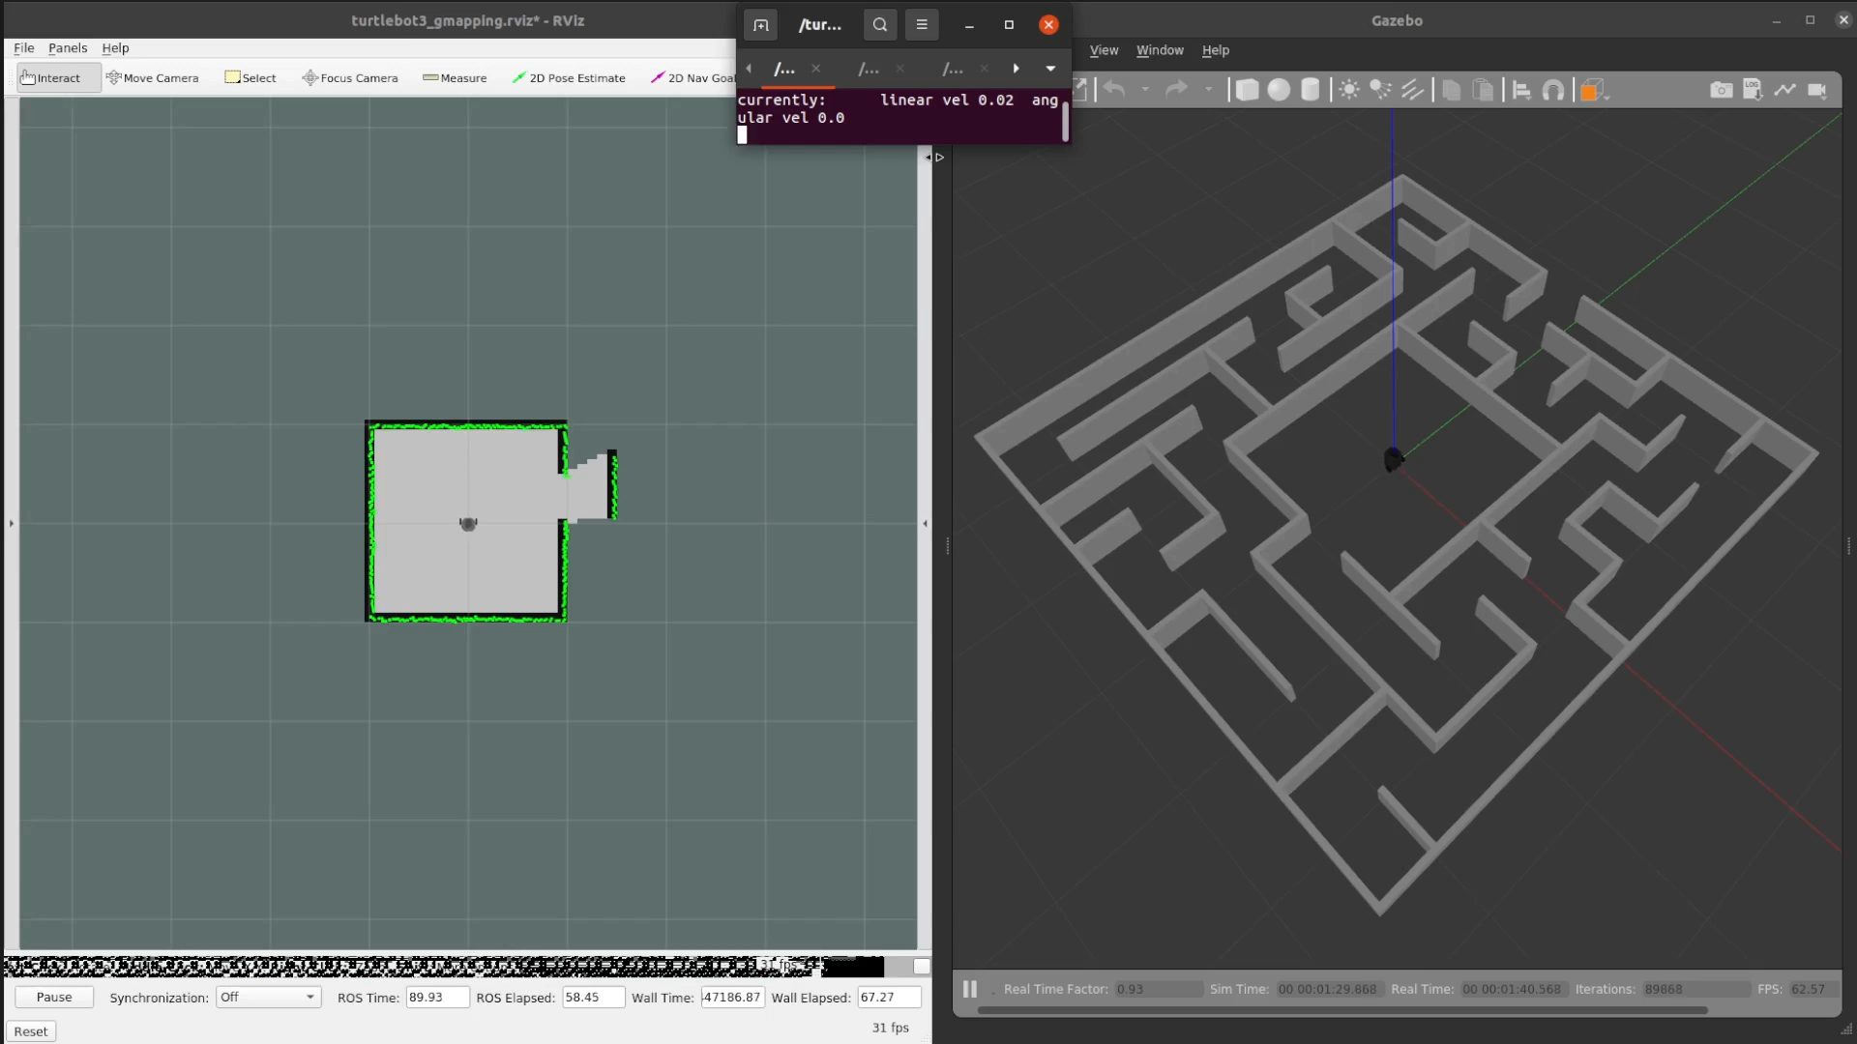
PROJECT STATUS
State 8.05.2023
Finished
2 Maze worlds are already created
SLAM Implementation from docker running
Steering of robot using keyboard
Current work
Mapping and general navigation
Implementation of escape algorithms

Slide 7


THANK YOU!

Slide 8
PROJECT MATERIAL
A*
http://theory.stanford.edu/~amitp/GameProgramming/AStarComparison.html
https://algorithms.discrete.ma.tum.de/graph-algorithms/spp-a-star/index_en.html
https://qiao.github.io/PathFinding.js/visual/

Slide 9
MIDWAY
Midway Presentation: This first presentation is meant to tell the class about your project idea and showcase your initial work towards achieving your project goals. This presentation should include the following slides:
1 slide: Team name & team members
1 slide: Project topic (please make changes to reflect any changes in the project topic since the initial idea presentation)
1 slide: 2-3 overarching goals that your team wants to accomplish through this project
For each major component of your project (e.g., the ML-based navigation project could be organized into three components 1) perception, 2) robot navigation and 3) the algorithm):
1 slide: Description of the component
1 slide: Your group's current progress on this component (gifs, screenshots, and/or videos encouraged) -- it's ok if you haven't started on a component yet
All team members are expected to speak during this midpoint presentation. Also, your presentation should take between 5 and 7 minutes (we will cut you off at 7 minutes).

